Slide 1
Baseball
Player Management System
Final Presentation
Seth Friman, Sophie Lefebvre, Grace Michael, Tara Sawhney, Jason Stitt
Notes:
Jason

Slide 2
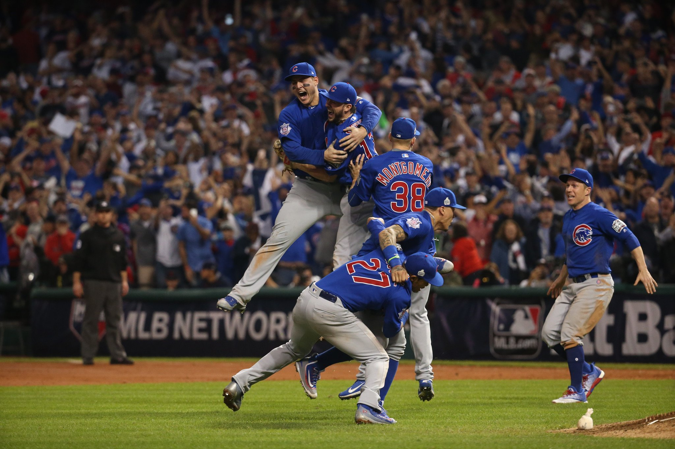
Introduction
Emphasizing Importance of Data Science in Sports
How can statistics be used to influence coaching and management decisions?

Slide 3

The Data
From FanGraphs:
Batter Stats
Game logs
Total
Vs. LHP
Vs. RHP
Pitcher Stats
RHP
LHP
From The Baseball Cube:
Organizational Rosters
Used for position
Notes:
Jason

Slide 4
Data Cleaning
Standardize Labels
Separate Stats
Create Player Objects
Make sure that positions, team abbreviations, and player names were all consistent and accurate
Each player needed to be iterated through to find in game statistics against each type of pitcher
Pitchers and Batters were made into objects that stored player metadata and a dictionary of game stats
Notes:
Seth: Data Cleaning Slide/ weighting/ manipulating

Slide 5
Data Limitations
AL vs NL
Free Agents
National League does not have a rostered DH
Rosters won’t include players who are signed this offseason (can be updated later)
Notes:
Sophie
National league teams do not have a dh in their lineup because they don’t have rostered dh’s
We dropped free agents because they’re not officially signed to a team (no position)
Once a free agent has been signed to a team, we can update our code to reflect that

Slide 6
COMPONENT ARCHITECTURE
Player Class
Roster Class
Matchup Creator
Pitcher Selector
Line-up Generators
Visualizations & Analysis
Batter and Pitcher Subclasses
Houses Player
Objects
Random Home/Away
Teams
One Starting Pitcher from each Team
3 Different Methods
Notes:
Jason

Slide 7
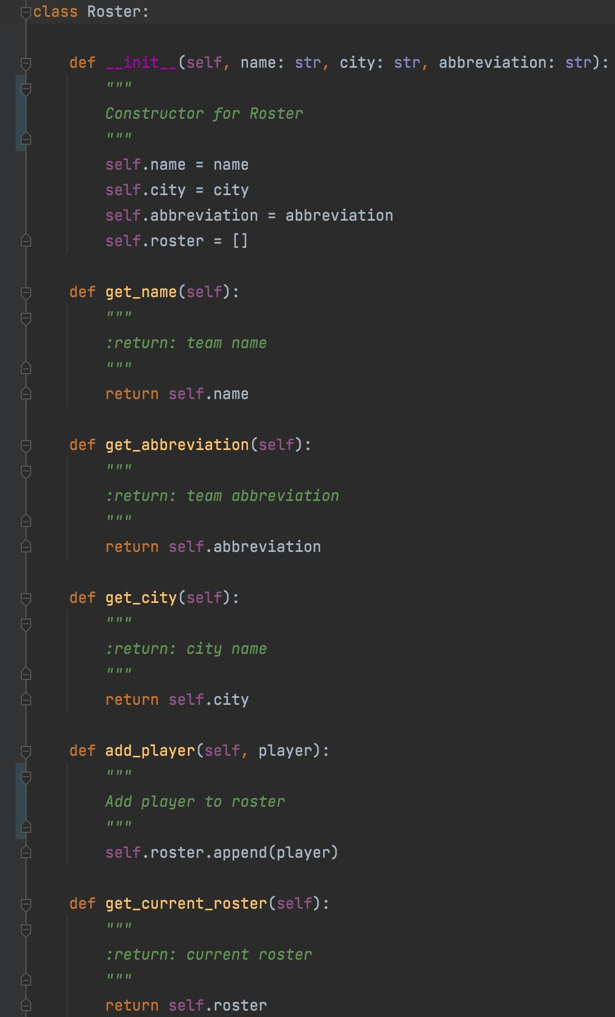
Roster Class
Methods
Purpose
get_name
Returns team name
get_abbreviation
Returns team abbreviation
get_city
Returns city
add_player
Adds player object to roster
get_current_roster
Returns roster as list
Roster allows for all player objects in a team to be easily organized in a list
Stores pitcher handedness and player position for entire teams which is used when determining possible lineups
Notes:
Sophie

Slide 8
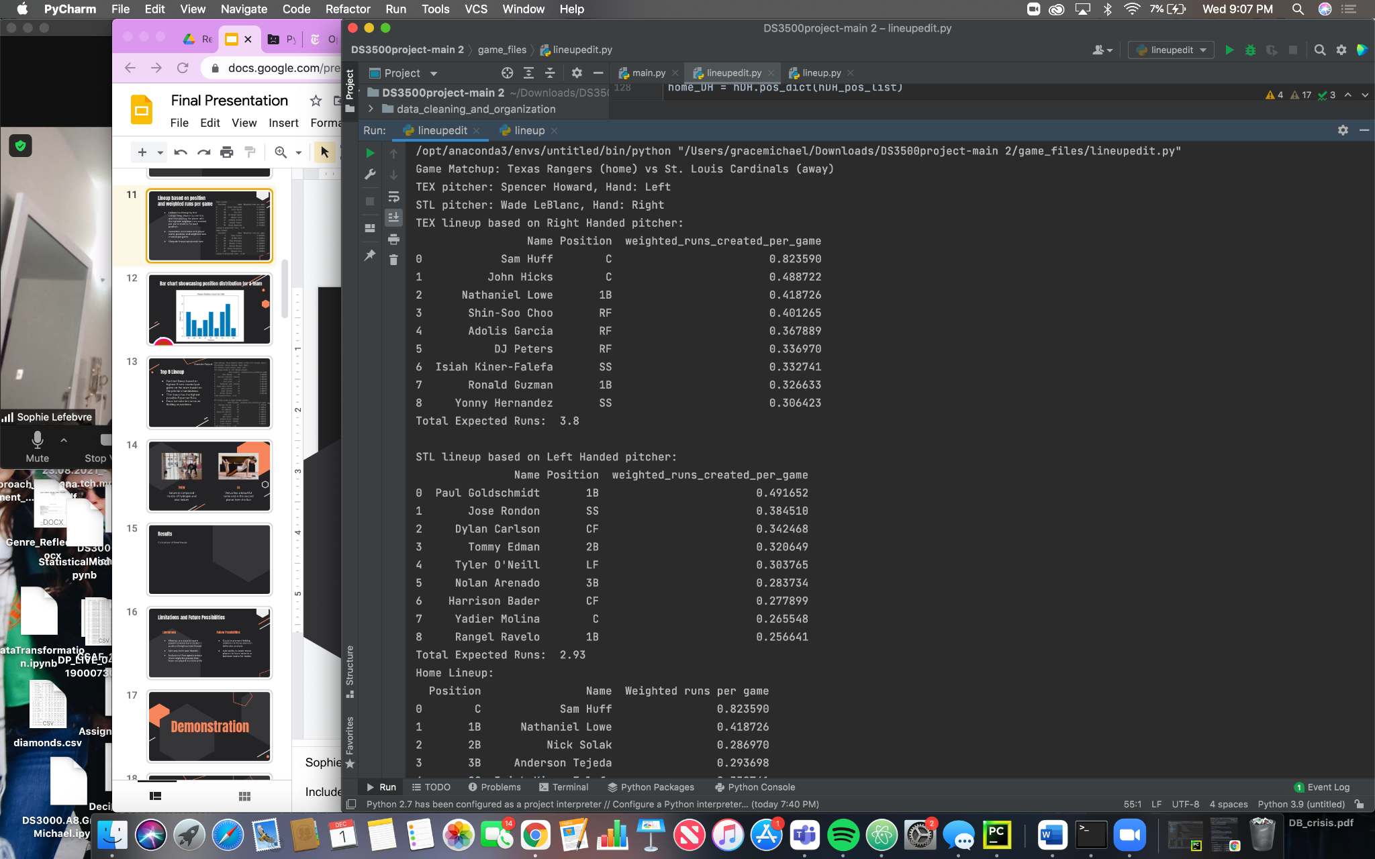
Matchup Creator
Method
Picks two unique teams from the MLB
Each team has to be unique
Can’t play yourself
The first team is assigned as home and the second team is assigned as away
genMatchup functionality and specificity in making a match-up
Notes:
Grace: Matchup creator and pitcher generator

Slide 9
Pitcher Generator
Method
Takes all player objects from selected roster with position “P”
Randomly selects a pitcher
If specified as a ‘RP’, they were not included as a ‘P’
Confirms handedness of pitcher
Printed separately as our lineups are for offensive players
Notes:
Grace: Matchup creator and pitcher generator

Slide 10
Stat Weights
Goal
Process
Manipulate individual game data to be more reflective of recent play trends
Use new weighted stats to generate weighted metrics for comparison
Used inverse distance formula to give more strength to recent games and less strength to games that happened a while back
Aggregated each game to compute a new value for each basic statistic
Stats
Individual Game Stats Used/Weighted:
'G', 'PA', 'AB', 'H', '1B', '2B', '3B', 'HR', 'R', 'RBI', 'BB', 'IBB', 'SO', 'HBP', 'SF', 'SH', 'GDP', 'SB', 'CS'
G (games) included to give weight to number of games played
Date | Name | Tm | G | PA | AB | H | 1B | 2B | 3B | HR | R | RBI | BB | IBB | SO | HBP | SF | SH | GDP | SB | CS | AVG
2020-07-23 | Giancarlo Stanton | NYY | 1 | 3 | 3 | 2 | 1 | 0 | 0 | 1 | 1 | 3 | 0 | 0 | 1 | 0 | 0 | 0 | 0 | 0 | 0 | 0.66666667
2020-07-23 | Asdrubal Cabrera | WSN | 1 | 2 | 1 | 0 | 0 | 0 | 0 | 0 | 0 | 0 | 1 | 0 | 0 | 0 | 0 | 0 | 0 | 0 | 0 | 0
Notes:
Seth

Slide 11
New Stats
Previous weights used to generate new descriptive statistics for batters
Calculated Stats: AVG, OBP, Total Bases, Runs Created, Runs Created Per Game
Used Runs Created Per Game in lineup generation
best inclusion of all basic batting statistics
gives credit to players who may not have had as many total games
Notes:
Seth

Slide 12
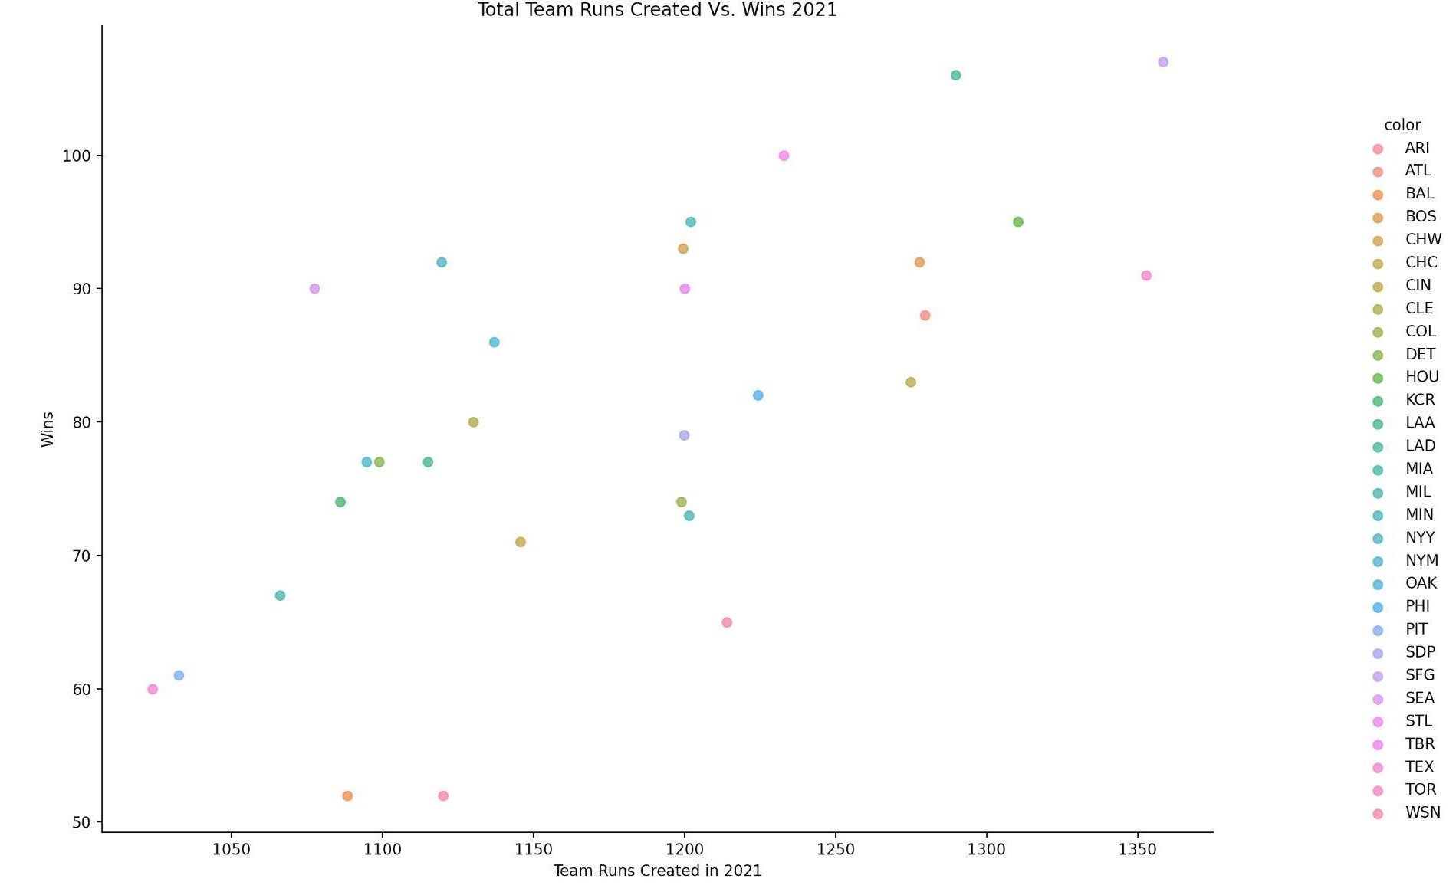
2021 Wins Vs. Runs Created
Notes:
Jason

Slide 13
Line-ups
Position and Weighted runs per game
Top 9 Batters
Random
Returns a Lineup of the best batter in each position
Returns a Lineup of the best 9 batters
Returns a Lineup of random batters
Notes:
Grace

Slide 14
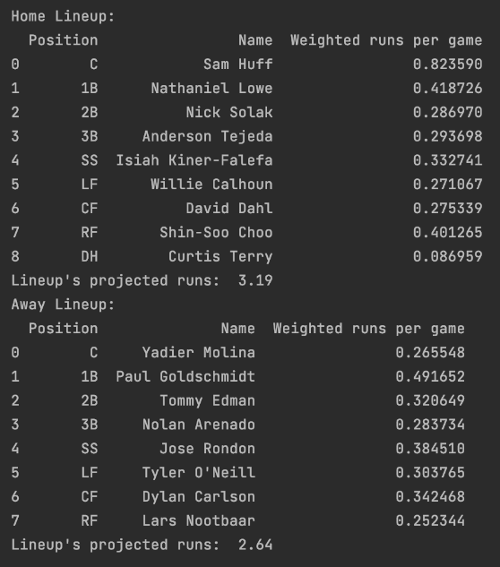
Lineup based on position
and weighted runs per game
Determined lineup by first categorizing players by position, and then picking the player with the highest weighted runs created per game statistic for each position
Generates dataframe with player name, position, and weighted runs created per game
Outputs the lineup’s projected runs
Notes:
Sophie/Grace
Include example output with both home and away df printed
If team does not have an assigned DH, this position is filled by the player with the highest weighted runs created per game statistic that is not already in the lineup
National league has no DH so if there isn’t one, it’s assumed that a manager would fill the position with the next best batter, and we hope we have time to make our code present our person for them

Slide 15
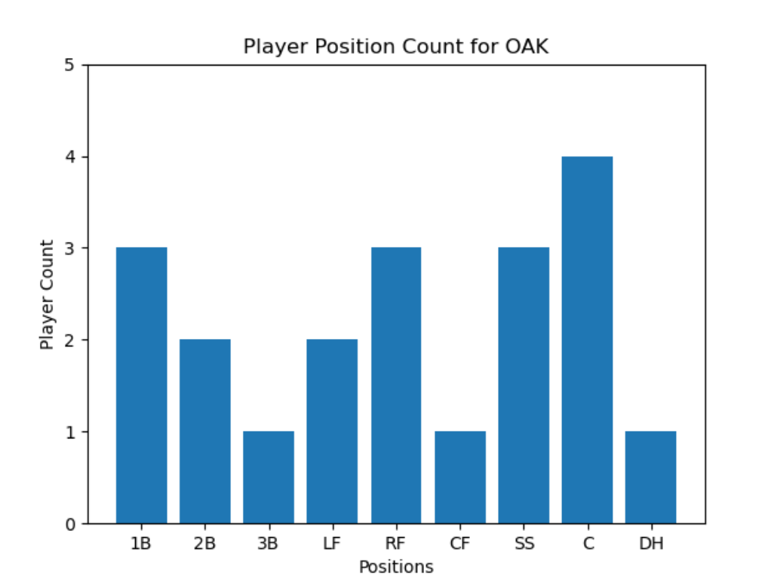
Bar chart showcasing position distribution for a team
Notes:
For oakland athletics
Can tell a manager which position to look for during trading (positions with low numbers)
Also tells a manager that the player picked for a certain position might be due to necessity (only one option), so you can’t expect them to have stats to the highest standard compared to the rest of the league

Slide 16
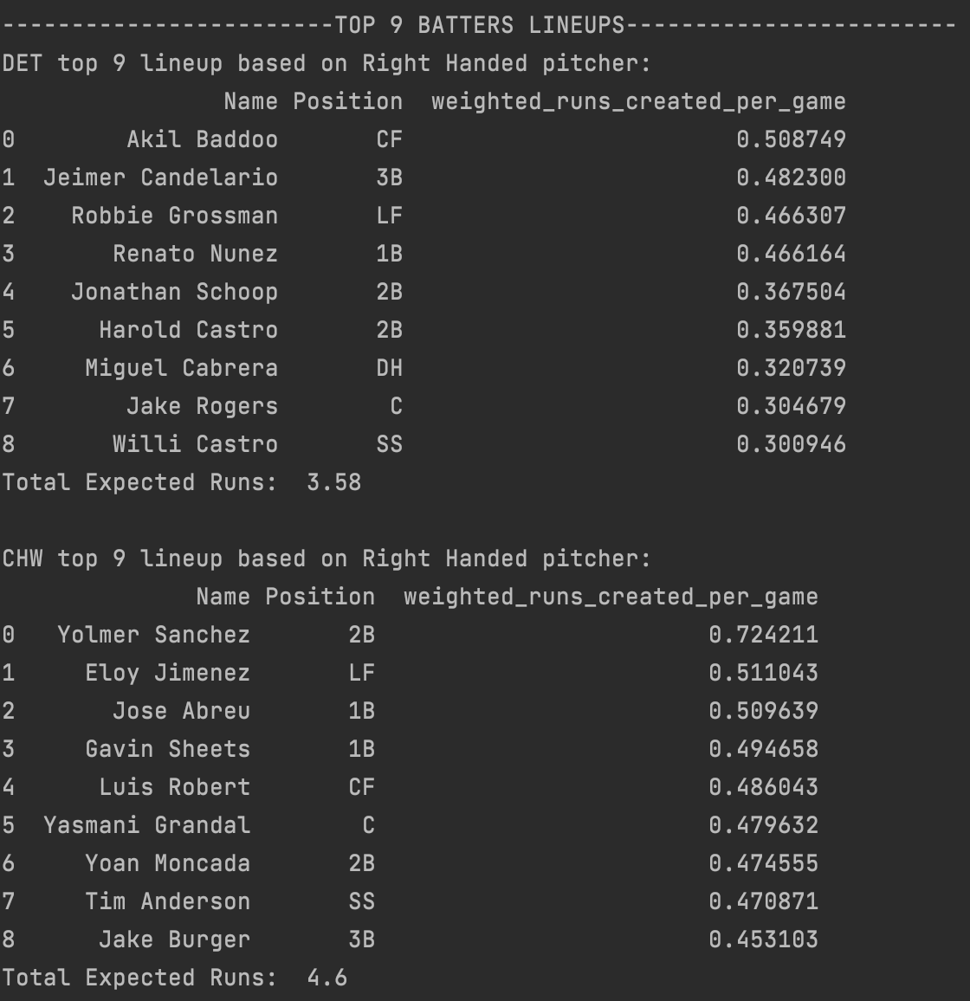
Top 9 Lineup
Decided lineup based on highest 9 runs created per game on the team based on the pitcher’s handedness
This lineup has the highest possible Expected Runs
Does not take into account fielding or positions
Notes:
Seth

Slide 17
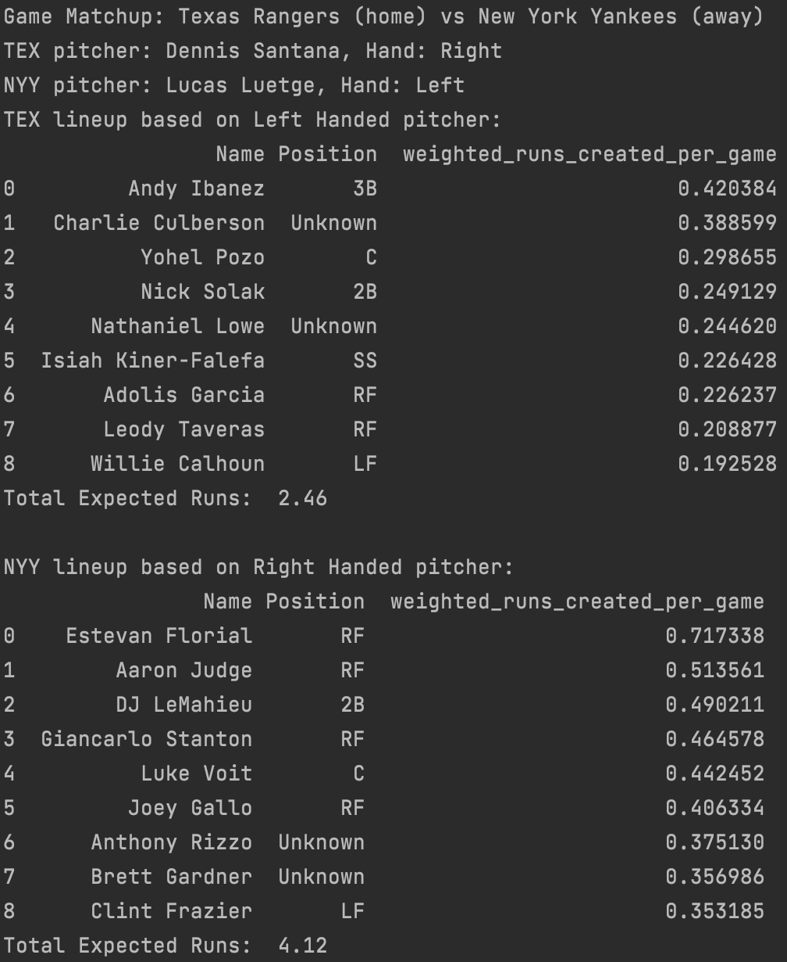
Random Lineup
Decided the random lineup of 9 players based on the pitcher handedness
Generated the lineup based on the opposing pitcher
For example - if pitcher is right handed, grabbed left-handed players
Used python’s random.choice to pick the random players
Notes:
Tara
We created a lineup of random batters
This lineup was generated based on the opposing pitcher, so for instance, if the generated pitcher is right-handed, the line-up will consist of left-handed batters
Expected runs are not going to be as high as the top 9 lineup and the positional lineup
Returns dataframe of name, position, and weighted runs created per game

Slide 18
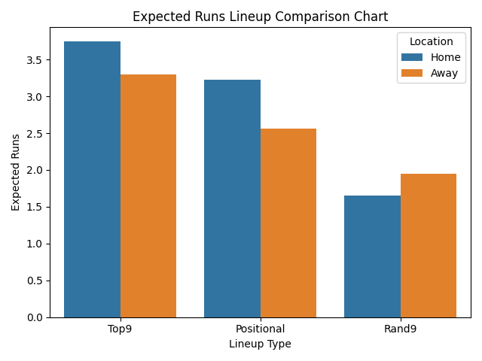
Lineup
Results & Analysis
Some offensive sacrifices must be made for a sufficient defense
Strong offensive players are also playing defense
Notes:
Grace
Phillies vs Orioles

Slide 19
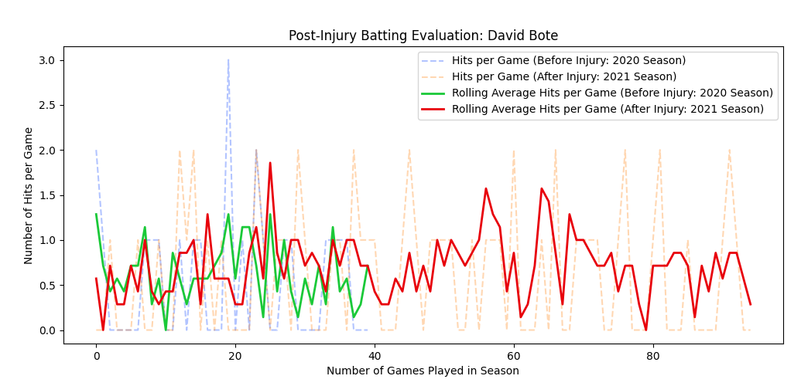
Data Analysis
Notes:
Grace
David Bote: 3B Chicago Cubs
Dislocated his shoulder halfway through the 2020 season
Officially returned to play for the 2021 season
Calculated rolling averages to filter out the “noise” from the small, frequent fluctuations
He played about 40 games in 2020 before getting hurt and he made it all the way through the 2021 season
During the first 40 games, his rolling averages appear to have a similar rise and fall pattern with a slight spike around 25, however he appears to get fatigued as the season progresses
The rolling averages past the point of comparison show much more sever rise and fall patterns before tapering slowly, showing that either A. his injury is causing him to be fatigued long term or B. he may be a better front half of the season player.

Slide 20
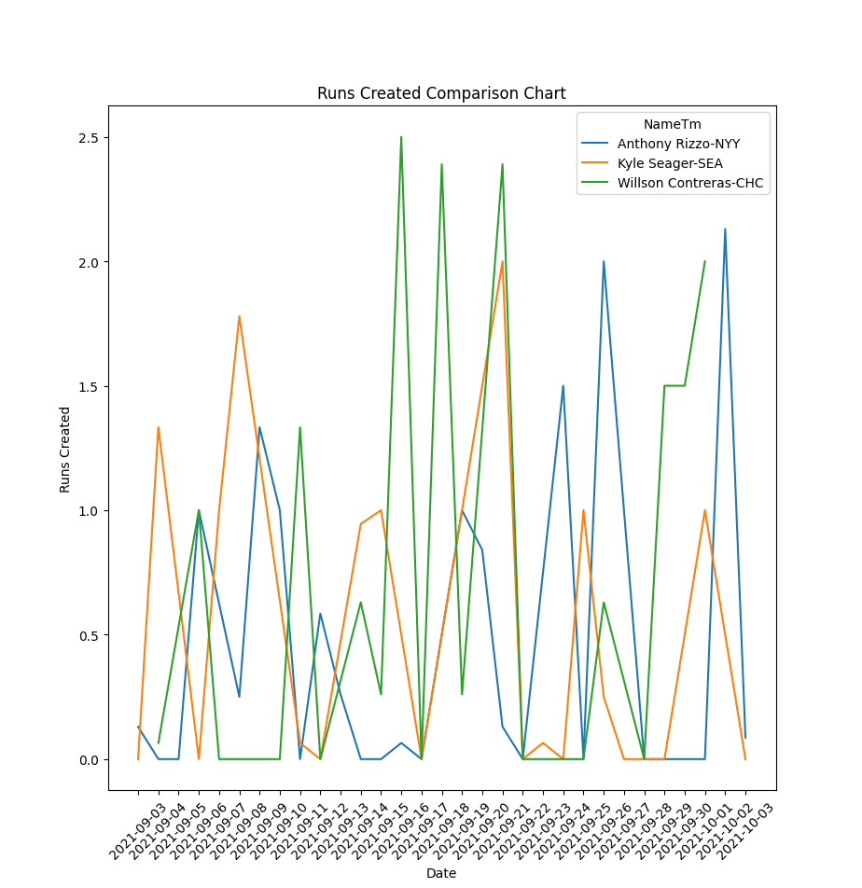
Notes:
Jason

Slide 21
Future Possibilities
Could implement fielding statistics to focus more on defensive analysis
Add ability to easily move players to injury reserve or between teams for trades
* it is important to note that professional player management systems are constantly being developed, so there is no definite end to this project
Notes:
Sophie
Has ability to calculate all of these things (diff visuals)
Haven’t utlilized fielding stats → in future use for defensive analysis
Free agents
Needs to be more front user friendly (when trades happen or when need to be moved to injury reserve)

Slide 22
Demonstration
Notes:
Seth

Slide 23
Thanks for listening! Any questions?

Slide 24
Works Cited
http://www.thebaseballcube.com/mlb/rosters/current.asp?T=7&View=40man
https://baseballsavant.mlb.com/leaderboard/custom?year=2021,2020,2019,2018,2017,2016,2015&type=batter&filter=&sort=1&sortDir=desc&min=q&selections=player_age,b_ab,b_total_pa,b_total_hits,b_single,b_double,b_triple,b_home_run,b_strikeout,b_walk,b_k_percent,b_bb_percent,batting_avg,slg_percent,on_base_percent,on_base_plus_slg,woba,&chart=false&x=player_age&y=player_age&r=no&chartType=beeswarm
https://www.mlb.com/stats/
https://en.wikipedia.org/wiki/Runs_created
https://www.fangraphs.com/leaders/splits-leaderboards?splitArr=97&splitArrPitch=&position=P&autoPt=false&splitTeams=false&statType=player&statgroup=1&startDate=2020-03-01&endDate=2021-11-01&players=&filter=&groupBy=season&sort=-1,1
https://www.fangraphs.com/leaders/splits-leaderboards?splitArr=96&splitArrPitch=&position=P&autoPt=false&splitTeams=false&statType=player&statgroup=1&startDate=2020-03-01&endDate=2021-11-01&players=&filter=&groupBy=season&sort=-1,1
https://www.fangraphs.com/leaders/splits-leaderboards?splitArr=1&splitArrPitch=&position=B&autoPt=true&splitTeams=false&statType=player&statgroup=1&startDate=2021-03-01&endDate=2021-11-01&players=&filter=&groupBy=season&sort=-1,1

